Slide 1
PROTECTING AGAINST ELECTROSTATICS DISCHARGE

Slide 2

What is electrostatic discharge(ESD) ?
ESD is a discharge at very high voltage and very low current
ESD can range from 100 to 10,000 of volts.
So , ESD can be hazardous for sensitive electronics devices.

Slide 3
ESD transfers electrical charge in three stages:
Pickup
Storage
discharge
Sources of charges:
Work surface, floors , clothes, etc.
Usually, mechanical rubbing between dry, insulated material transfer the charge from the source to storage.

Slide 4
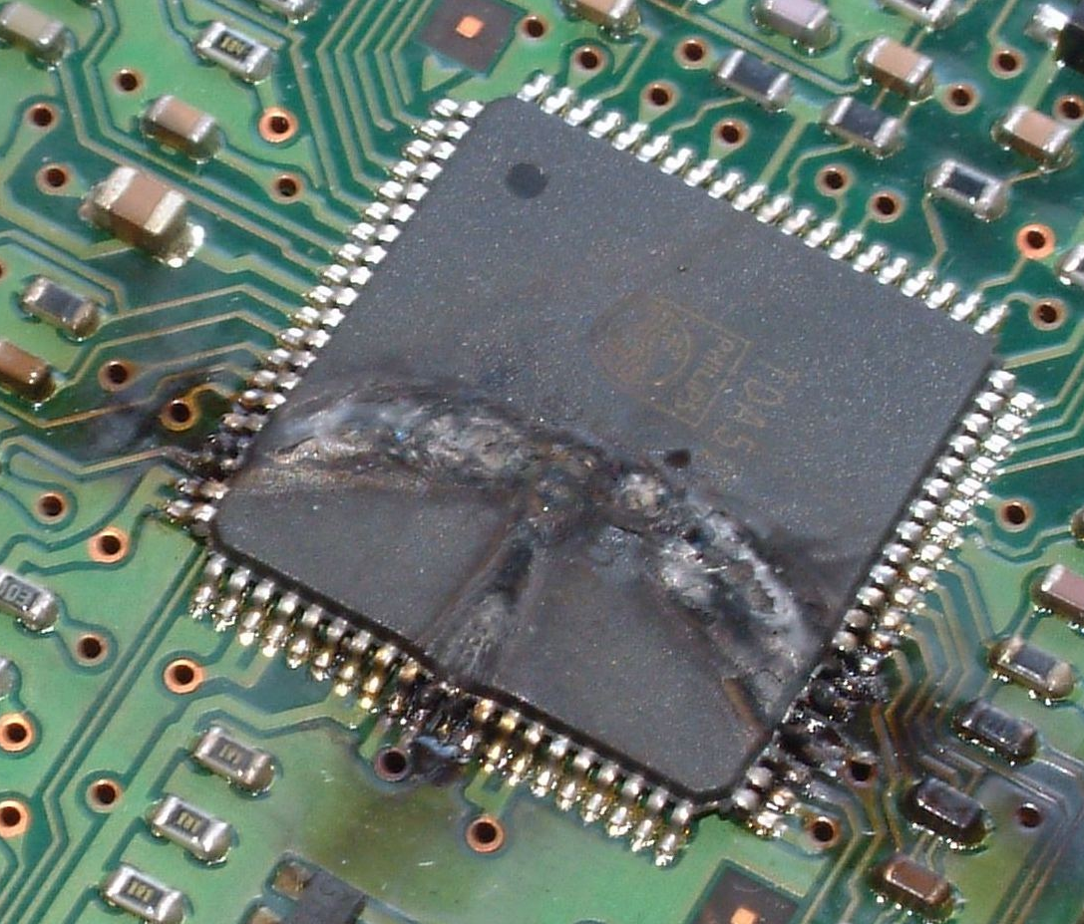
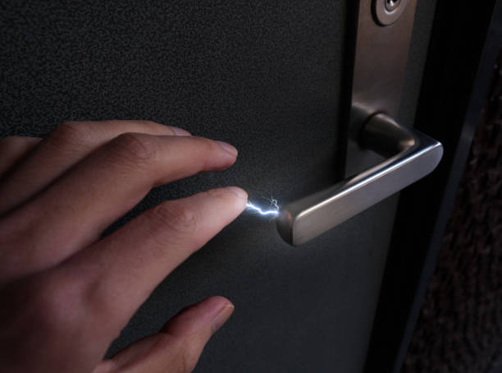
Often, the storage medium is a person , who unwillingly delivers the damaging discharge.
Physical contact discharges the charge from the storage.
If a person touch the sensitive electronics devices then it can damage it.

Slide 5
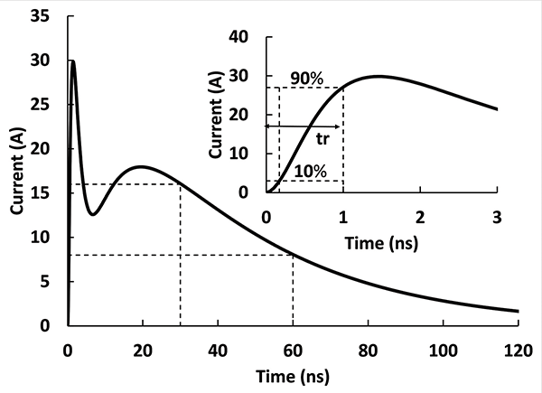
The discharge waveform of ESD has a fast rise time and short duration.

Slide 6
Different schemes for protecting the circuit from ESD:
Grounding
Shielding
Transient limiter

Slide 7
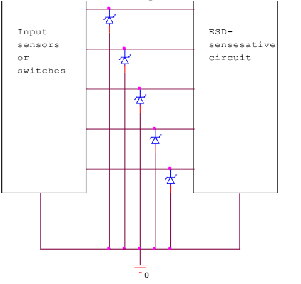
Fig: Preventing damage by shunting high voltage transients away from circuits with zener
diodes

Slide 8
Review of Zener diode
1. Special Diode: A Zener diode is a special type of diode used for voltage regulation. It's designed to work in reverse bias, meaning electricity flows against its natural direction.
2. Voltage Drop: Zener diodes have a specific voltage, called the "Zener voltage," at which they start allowing current to flow in reverse. This voltage is like a checkpoint.
3. Voltage Regulator: When you connect a Zener diode in reverse bias across a power supply, it acts like a valve for voltage. If the supply voltage tries to go above the Zener voltage, the diode lets some current pass, keeping the voltage across the load constant.
4. Stable Output: This process helps in voltage regulation. If the supply voltage fluctuates, the Zener diode adjusts its current to keep the output voltage steady, protecting sensitive components from voltage variations.
In essence, a Zener diode is like a voltage checkpoint that ensures a stable output, acting as a regulator for electronic circuits.

Slide 9
How zener diode helps in protecting the sensitive electronic devices?
Voltage Control: Zener diodes act like a safety valve. When a surge of static electricity (ESD) arrives, the Zener diode limits the voltage to a safe level, preventing it from going too high and damaging the sensitive device.
Quick Response: Zener diodes are super-fast responders. They react instantly to the sudden surge of electricity during ESD. This rapid reaction keeps the voltage from rising too quickly and harming the sensitive electronics.
Reverse Bodyguard: Zener diodes work backward to protect. Normally, they're set up the opposite way, and when ESD happens, they create a low-resistance path for the dangerous surge. This redirects the harmful energy away from the delicate parts.
Energy Eaters: Zener diodes can handle a lot of energy. During ESD, they soak up the excess energy like a sponge, preventing it from reaching the sensitive electronics and causing damage.
So, Zener diodes are like the guardians of sensitive devices, keeping them safe from the sudden shocks of static electricity.

Slide 10
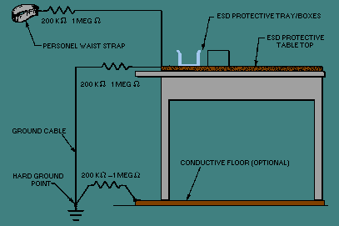

Following are the checklist to make work area less prone to ESD:
Use as “static-free” workstation and wear a wrist ground strap.
Discharge static before handling devices.
Pick up devices by their bodies, not their leads.
Never slide a semiconductor over any surface.

Slide 11
THE END

